Slide 1
Hướng dẫn trước khi đọc slide
Cài font chữ dùng cho slide (Làm ơn hãy cài, vì nó đẹp)

Slide 2
cerebro.
Notes:
Hi, everyone, our team are Cerebro, welcome to our presentation for the solution of the VPBank Technology Hackathon.

Slide 3




members
Tuấn Anh
Data Analyst
1. Define data models
2. Build dbt models
3. Build dashboards
Phương Hoa
Data Analyst
1. Define data models
2. Build dbt models
3. Build dashboards
jazz Dũng
Cloud Engineer
1. Simulate sources
2. Everything AWS
3. Kubernetes
Bá Hiếu
Fullstack Developer
1. Build API server
2. Build web application
cerebro
1
Notes:
And here are our team members:

Slide 4


architecture diagram
AWS Cloud
Sourcing
Structured Data (Relational Database, Parquet )
Semi-structured Data (JSON, CSV, XML)
Unstructured Data (Images, Audio)
Data comes from FTP Server, Databases, Kafka streams and S3 buckets
Data Integration
Use Big Data technologies to ingest / read data from sourcing, process, and load to Relational Database
Create relationships, entities, enrich Graph Database using aggregated data from Relational Database
Can process data by batch, or near real time for streaming data
Data Lake
Transformation & Analytics
SQL Transformation
Data Quality
Data Dictionary
Data Masking
Relational & Graph Data Warehouse
Relational database
Graph database
API
Handle requests, build Query from request arguments
Execute against Databases and return result in workable format
Dashboard & Reporting
Build dashboard, conduct analysis using relational and graph databases as source of data
Allow embed analytics to use in Frontend
Frontend
Show the overview of how data is organized
Present customer data for Business / Marketing / CX users in a logical, easy to eyes manner, support decision making.
HTTP requests
User
cerebro
1

Slide 5

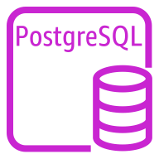


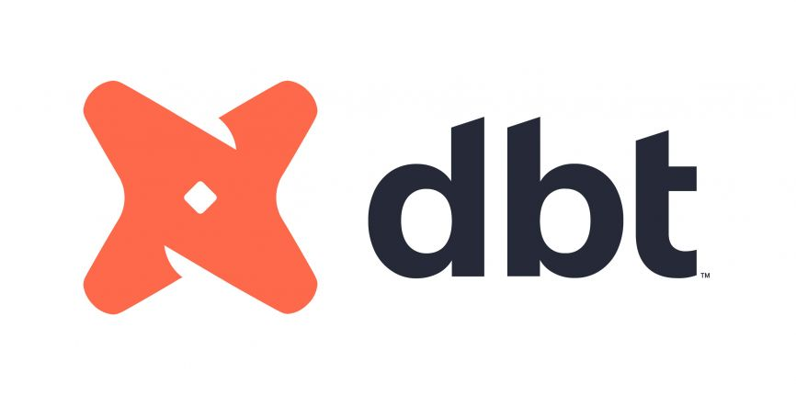








architecture diagram
AWS Cloud
Sourcing
Amazon MSK
Behavioral Data
PostgreSQL instance
3rd party Data
Amazon Glue
Data Integration
Amazon S3
Unstructured Data
Data Lake
Development
Transformation & Analytics
Databases
API
Pull dbt project
Amazon EKS
dbt and airflow project
PostgreSQL instance
Relational Database
AWS Lambda
Execute Query
Orchestration
Run as service
Amazon ECR
Airflow Custom Image
Neo4j Instance
Graph Database
Amazon API Gateway
Query API
Dashboard
Frontend
Amazon EKS
Superset Instance
Amazon ECR
Web Application Image
Amazon EC2 web server
HTTP requests
User
cerebro
1

Slide 6




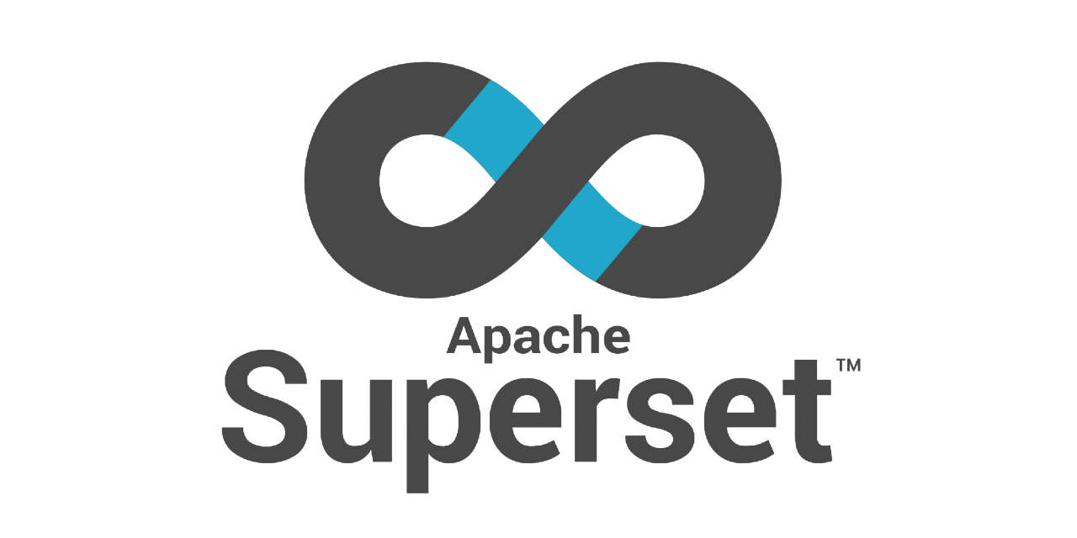

architecture diagram
(abstracted)
Sourcing
Integration
Data Warehouse
+
K8s cluster
Web app
API Server
Transformation
Dashboard
+
cerebro
cerebro
1
Notes:
The technical documentation already have the detailed architecture, so here is just an abstract overview of our solution, data from sources being integrated into databases. We then implement further transformation to create physical tables for end users. These tables can be visualized on a dashboard, query using an API or preview on a Web application. Finally, some components will be hosted on a Kubernetes cluster.

Slide 7
sourcing simulation
cerebro
3
Notes:
For this solution to work, we need to simulate some of the data presented in retail banking

Slide 8

sourcing simulation
CSV
Bank Branch
S3
Customer info
Account info
Branches
XML
Customer info
Account info
Savings account
Loan
External DB
Transaction
Savings transactions
Loan payment
Source
Replicate Retail Banking data
API
ATM information
cerebro
4
Notes:
Data will come from 3 sources: S3 buckets, External Database and APIs

Slide 9
data integration
cerebro
5
Notes:
And we will use AWS Glue to integrate them into our databases

Slide 10
data integration
(source -> relational db)
Glue Environment
S3 files
External DB
Catalog Table
Spark Dataframe
Relational Database
API
JSON
cerebro
6
Notes:
We write pyspark scripts to read data from sources into spark dataframes, perform basic transformation and load them into our relational databases

Slide 11
data integration
(relational db -> graph db)
Glue Environment
Construct query to create Nodes
Relational Database
Spark
Dataframe
Graph Database
Construct query to create Relationship
cerebro
7
Notes:
After that, we will read some of the specific tables from relational databases into spark dataframes, use function to generate the Cypher queries to create graph nodes and relationships then execute them on the neo4j instance.

Slide 12
data transformation
cerebro
8
Notes:
Most of the transformation on relational database will be performed using dbt

Slide 13
data transformation
(transformation layer)
Staging
First transform tables of the imported data
Cleaning, restructuring, cast data type
Masking PII data
Often stored as views
Intermediate
Intermediate calculation tables
Often stored as views or ephemeral
Mart
Tables designed according to dimensional modeling, oriented for end-user use
Convenient for users to easily search tables by functions and task
Store as physical tables
cerebro
9
Notes:
We divide our models into 3 layers. Staging for data cleaning, type casting and PII data masking. Most models of this layer will be views. Next is intermediate layers for middle step transformation, also stored as views. Finally, physical tables designed for end-users will be stored in the mart layer.

Slide 14




data transformation
(orchestration)
Airflow
Pull dbt project into local repository
Design DAGs to execute dbt commands
cerebro
10
Notes:
To orchestrate models execution. We setup an airflow project that can pulls dbt project from github / gitlab to it own local repository and execute models on to the relational database.

Slide 15
API
cerebro
11
Notes:
While data engineer can directly query data from database, most of the departments will access them through a REST API.

Slide 16
api
Frameworks and features
Built on the Django framework
Following a three-tier architecture
Allow filters, sorting, paginate
{
"customer_id": "C183",
"identity_id": ”9a5a54a1b5d2165f207c8d3”,
"last_name": “Dũng”,
"first_name": “jazz”,
"date_of_birth": "2001-09-02",
"gender": “M”,
"address": -761,
"phone": "Thành phố Lạng Sơn, Lạng Sơn"
},
{
"customer_id": "C183",
"identity_id": ”9a5a54a1b5d2165f207c8d3”,
"last_name": “Dũng”,
"first_name": “jazz”,
"date_of_birth": "2001-09-02",
"gender": “M”,
"address": -761,
"phone": "Thành phố Hà Nội"
},
http://customer360/api/customers/?
query={
"gender":{"exact": "M"},
"age":{“lessThan":45}
}
&order_by={
"columns":["age"],
"type":["asc"]
}
Sample API call
cerebro
12
Notes:
These API allow queries on tables, filtering and record ordering based on columns values.

Slide 17
data visualization
+
web application
cerebro
13
Notes:
Data is ready, so we need someway to view them, either through a dashboard or a web application.

Slide 18
I think that it is best that I show you guys the real things
cerebro
14
Notes:
And for this feature we think that it is best that I just show you guys the real things

Slide 19
web application
cerebro
1

Slide 20
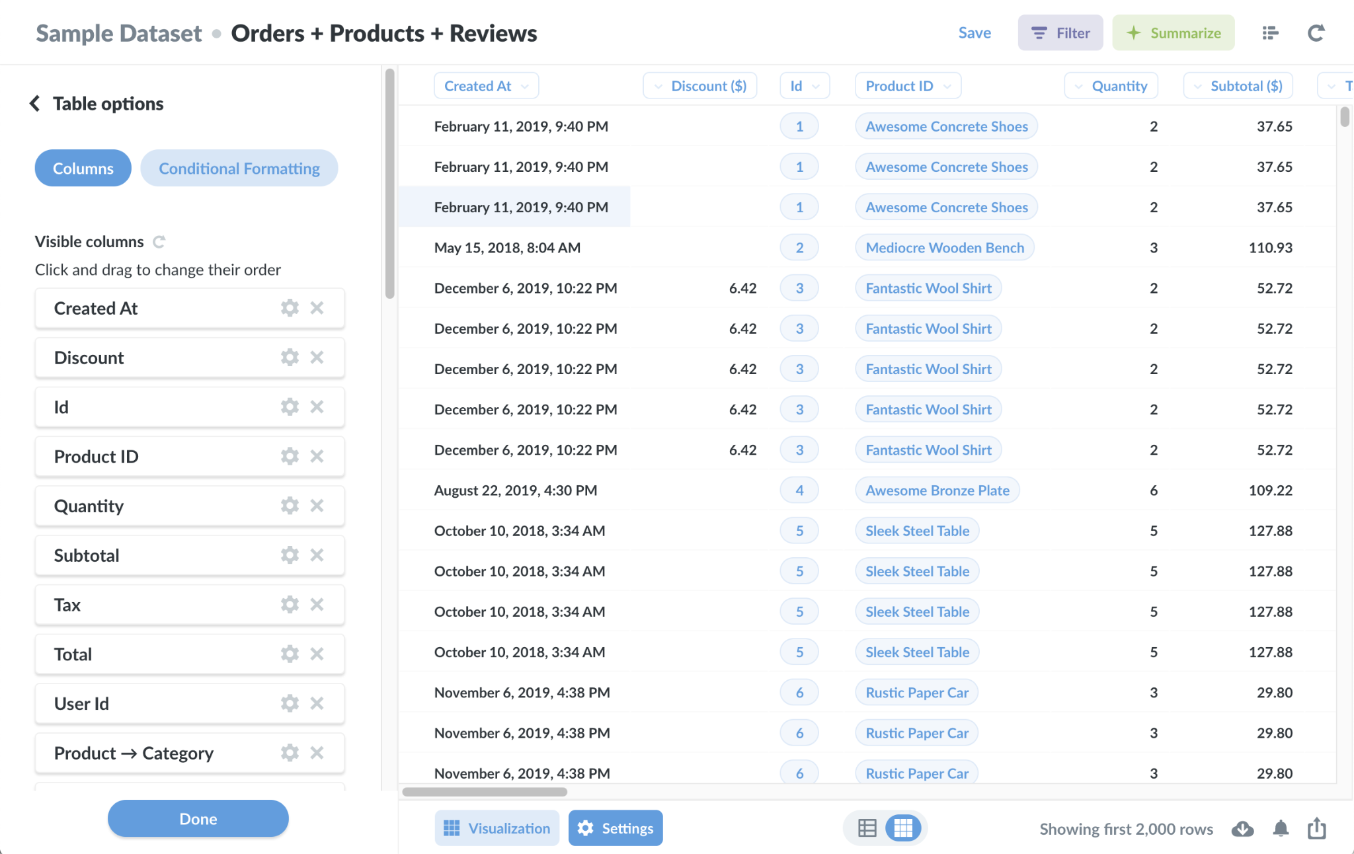
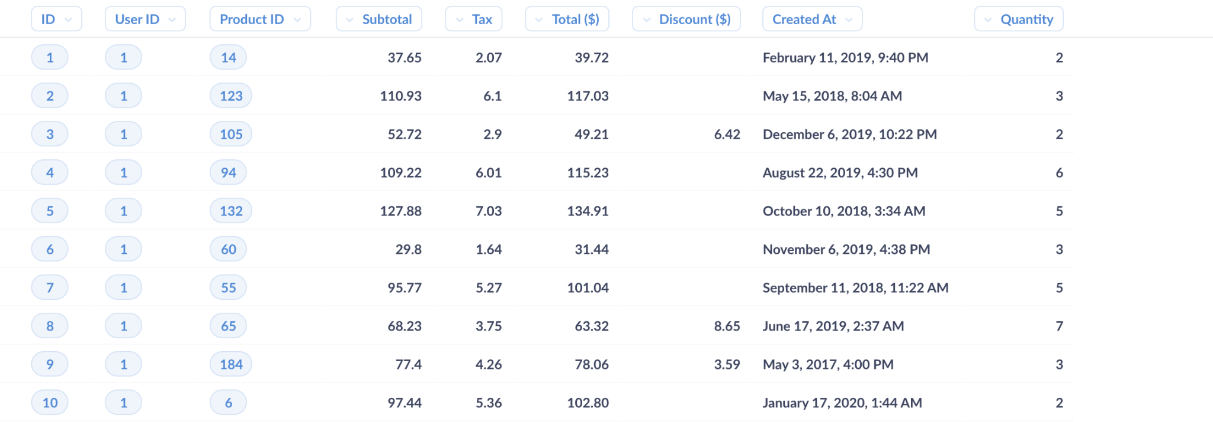
cost estimation
(table overview)
cerebro
1

Slide 21
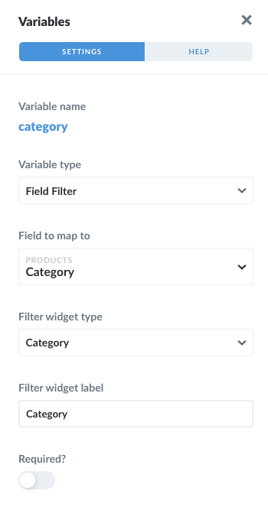
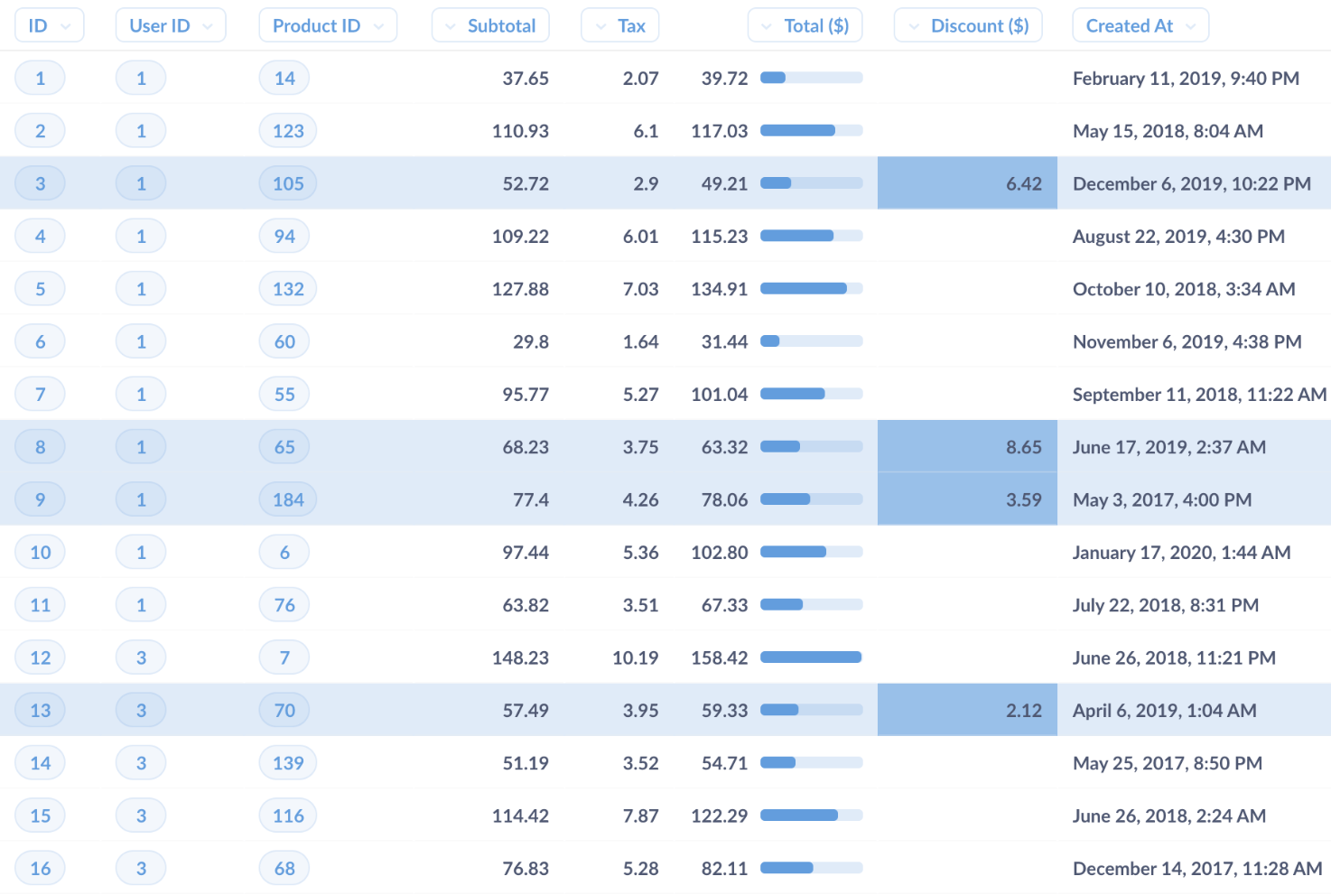
cost estimation
(table fitler)
cerebro
1

Slide 22
cost estimation
(API call builder)
https://mydb-fafc.restdb.io/rest/people?q={
"name" : {
"$in" : ["Joe", Jane"]
}
}
API
Copy
cerebro
1

Slide 23
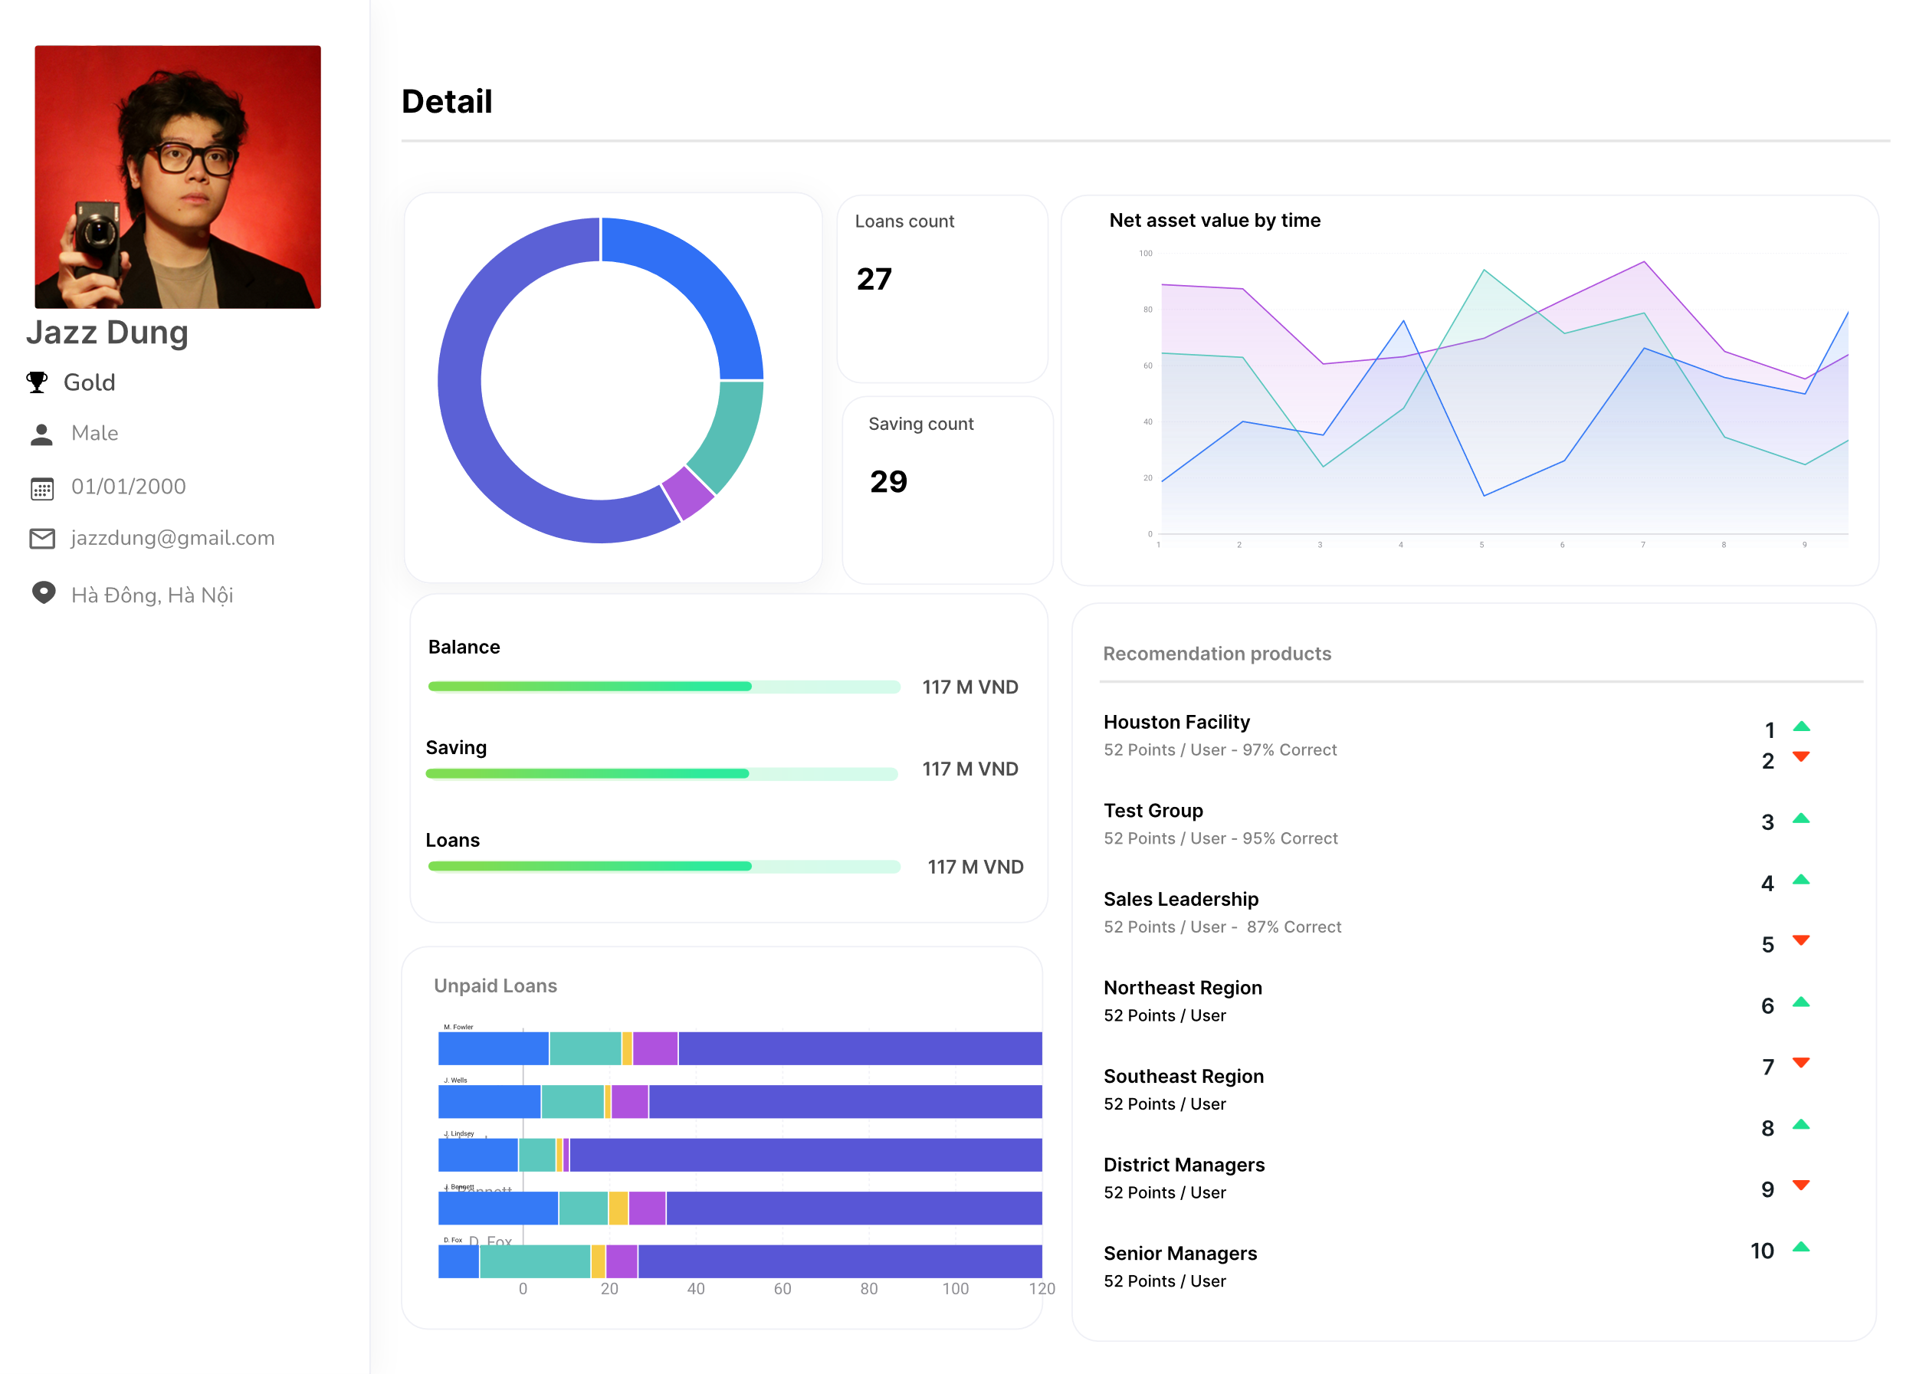

Slide 25
deployment
cerebro
15

Slide 26
deployment
(databases)
Relational DB
PostgreSQL
Managed by RDS
Graph DB
Neo4j
Hosted on EC2
cerebro
16
Notes:
Most of our solution will be host on a Kubernetes cluster, managed by EKS and contain a worker group of 3 ec2 instances.

Slide 27
deployment
(k8s cluster)
EKS
Control Plane
Worker
m5.large
Worker
m5.large
Worker
m5.large
cerebro
16
Notes:
Most of our solution will be host on a Kubernetes cluster, managed by EKS and contain a worker group of 3 ec2 instances.

Slide 28
deployment
(k8s services)
Customer 360
Cluster
Airflow repo
DAGs, connections
GitSync
Airflow
Superset
dbt repo
GitLab Pipeline
Push Image
ECR repo
dbt docs
Load Balancer
🌏
Internet Access
API Server
Web app repo
GitLab Pipeline
Push Image
ECR repo
Web app
cerebro
17
Notes:
There will be 4 main services divided into 4 namespace.
Airflow services with ability to sync DAGs from a git branch
The dbt docs web app for data dictionary, that will be updated with every single git commit using github action or gitlab pipeline
Superset for dashboard creation and ApI server for data query.
All 4 services have some type of web interface and we use load balancer to expose them for internet access.

Slide 29
cost estimation
cerebro
18
Notes:
A big solution, with many components, so how much will it cost to maintain when translated to actual scale of an organization like VPBank?

Slide 30
cost estimation
(glue: job)
Daily Glue jobs amount
1 DPU = 4 vCPU and 16 GB
Average run time
Days in month
DPU per hour cost
100 Jobs
x
5 DPUs
x
10 mins
(0.17 hour)
x
30 days
x
$0.44
=
$1,100
cerebro
1

Slide 31
cost estimation
(glue: crawler)
Glue crawler amount
1 DPU = 4 vCPU and 16 GB
Average run time
Days in month
DPU per hour cost
50
x
5 DPUs
x
5 mins
(0.085 hour)
x
30 days
x
$0.44
=
$225
cerebro
1

Slide 32
cost estimation
(rds: storage)
Record amount
Numeric Column
Size of one value
Text
Column
Size of one value
150,000,000
(
900 columns
8 bytes
100 columns
256 bytes
)
x
x
+
x
=
4.47 TB
cerebro
1

Slide 33
cost estimation
(rds: storage)
Data size
Storage cost per GB
Instances
Future Proofing
4577 GB
x
$0.23
x
2
x
1.5
=
$3,155
cerebro
1

Slide 34
cost estimation
(rds: instance)
m5d.4xlarge
Instances
Utilized %
Hours in a month
$3.352
x
2
x
50%
x
730 hours
=
$2450
cerebro
1

Slide 35
cost estimation
(neo4j: storage)
Record amount
Numeric Column
Size of one value
Text
Column
Size of one value
150,000,000
(
90 columns
8 bytes
10 columns
256 bytes
)
x
x
+
x
=
458.2 GB
cerebro
1

Slide 36
cost estimation
(neo4j)
EBS storage
c6g.4xlarge
Instances
Utilize %
Hours in a month
$750
$0.554
x
2
x
50%
x
730
+
=
$1075
cerebro
1

Slide 37
cost estimation
(eks)
Cluster Management
c6g.4xlarge
Instances
Utilize %
Hours in a month
$73
$0.554
x
3
x
50%
x
730
+
=
$670
cerebro
1

Slide 38
cost estimation
(eks)
Glue
Postgres (RDS)
Neo4j
(EC2)
Kubernetes
(EKS)
$1,375
+
$5600
+
$1075
+
$670
=
$8,795
(every month)
cerebro
19
Notes:
In the technical documentation, we have discussed the estimated size of data and the monthly cost of each services, and they will translated to a combined monthly cost of $8,795.

Slide 39
future improvements
cerebro
20
Notes:
We have a pretty complete and functioning solution, but there are still improvements to be made.

Slide 40
future improvements
(infrastructure)
Setup infrastructure with Terraform
Infrastructure as code
Parameterized deployment
Disaster recovery
Use Lambda functions to automatically:
Scale down / turn off hardwares on non-running periods
Scale up / turn on hardwares on spike periods
cerebro
21
Notes:
First of all is to implement infrastructure as code using terraform, which give us the benefit of very quick, parameterized deployment and disaster recovery. We will also construct some lambda functions to automatically scale our hardwares based on traffic and working hours.

Slide 41
future improvements
(data integration)
Handle streaming data with Table formats and AWS Glue
Use table format to create a schema definition for streaming records
Then create glue jobs to load them into database (batch or near realtime)
cerebro
22
Notes:
First of all is to implement infrastructure as code using terraform, which give us the benefit of very quick, parameterized deployment and disaster recovery. We will also construct some lambda functions to automatically scale our hardwares based on traffic and working hours.

Slide 42
future improvements
(database)
Move to a columnar database (Redshift)
Better performance
Better scalability
Better integration with AWS services
I know you would love to try RA3 (SSD for hot data, S3 for cold data)
cerebro
23
Notes:
For relational database, we will move to a columnar database, like Redshift for better performance and scalability.

Slide 43
that’s all
Notes:
And that’s all for today presentation. Thanks

Slide 44
QnA.start(
time_limit=300s
)
Notes:
And that’s all for today presentation. Thanks

Slide 45


future improvements
(lakehouse: better)
Data Integration
Transformation
Build big tables
Data Lake
Data Warehouse
Unstructured Data
Table format
Metadata
Query engine
Analytics
AWS
Glue
AWS
S3
Apache
Iceberg
AWS
Athena
Compute by spark instead of relational DB (Serverless, faster)
Use SparkSQL
Cheaper storage
Excellent for backup and historical data
All data in 1 place
Compute by spark instead of relational DB
Support queries on file-format and table-format
Sort-of dbt support (Not production ready)
cerebro
bonus pages

Slide 46

future improvements
(lakehouse: better)
If you dare to step out of the AWS ecosystem
Do most of the things above within a single coherent platform
Plus support for dbt!
cerebro
bonus pages

Slide 47
but for the sake of a hackathon sponsored by AWS, let’s just pretend I did not said that
Notes:
And that’s all for today presentation. Thanks

